Slide 1
Image Classification with Deep Convolutional Neural Networks
Helio Perroni Filho

Slide 2
Topics
Image Classification
Multilayer Perceptron Network (MLP)
Deep Learning Neural Network (DLNN)
DenseNet
Conclusion

Slide 3

Image Classification
Given an image I, assign it a label lI from a set L = {l₁, …, l_{n}}
Classical approach: use features extracted from images to train a classifier that relates feature vectors to labels
X
x1
x2
.
.
.
xn
Feature Extractor
(SIFT, SURF, etc)
Classifier
(SVM, MLP, etc)
“car”
Input
image
Feature
vector
Label

Slide 4
Multilayer Perceptron Network (MLP)
A perceptron neuron performs a biased weighted sum on input vectors followed by the application of a non-linear activation function
X
x1
x2
.
.
.
xn
1
w1
w2
Σ
Φ(.)
...
y
wn
b
Notes:
The activation function is optional for neurons in the output layer

Slide 5
Multilayer Perceptron Network (MLP)
Perceptron neurons can be arranged in interconnected layers to form a “fully-connected” network composed of:
  One input layer (I)
  One or more hidden layers (H)
  One output layer (O)
MLP’s can be used for classification or regression
  Classification: each output neuron ok represents the (unnormalized) likelihood that input I belongs to class k
  Regression: each ok represents the value of the k^{th} dimension of an output vector related to input I in some desirable way, usually normalized to range [0, 1] or [-1, 1]
H
I
O

Slide 6
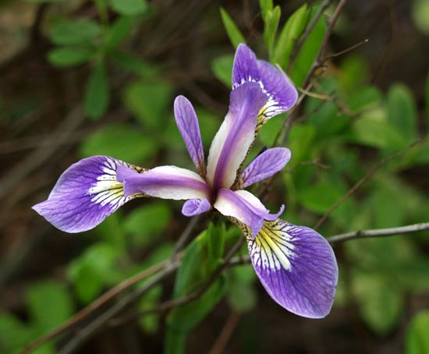
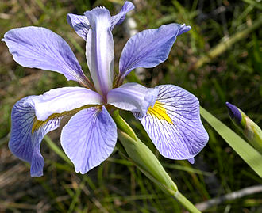
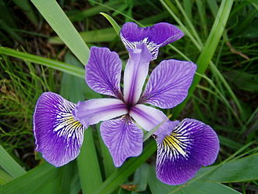
Multilayer Perceptron Network (MLP)
Classification example: identify species of Iris sp. flower
Inputs
  x1 - length of flower sepal
  x2 - width of flower sepal
  x3 - length of flower petal
  x4 - width of flower petal
Outputs
  y1 - likelihood of Iris setosa
  y2 - likelihood of Iris virginica
  y3 - likelihood of Iris versicolor
x1
y1
x2
y2
x3
y3
x4

Slide 7
Multilayer Perceptron Network (MLP)
Regression example: car controller
Inputs
  x1 - proximity to left curb
  x2 - proximity to right curb
  x3 - proximity to front obstacle
  x4 - car speed
Outputs
  y1 - steering angle in range [-1, 1]
  y2 - throttle output in range [-1, 1] (if < 0 means brakes are applied)
x1
x2
y1
x3
y2
x4

Slide 8

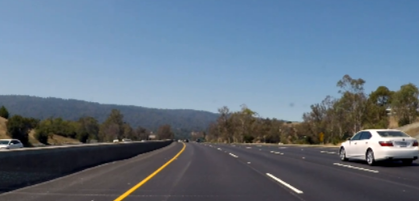
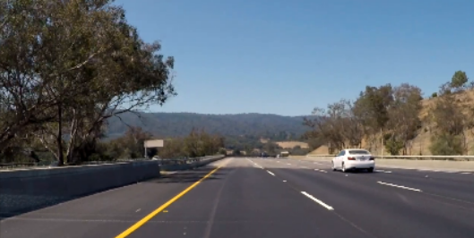
Multilayer Perceptron Network (MLP)
MLP’s don’t work well with spatial inputs (e.g. images)
  Curse of dimensionality
64
64
= 4096 input parameters
  Scale / position variance
Same object, different scale / position

Slide 9
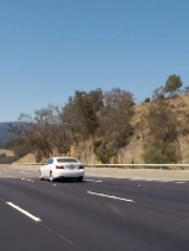
Multilayer Perceptron Network (MLP)
Solution: place a feature extractor between input and MLP
  Dimensionality reduction
  Scale / position invariance transforms
Can features be learned?
X
x1
x2
.
.
.
xn
x1
Feature
extractor
y1
x2
y2
...
...
...
ym
xn
...
Feature
vector
Classifier / regressor
(e.g. MLP)

Slide 10
Deep Learning Neural Network (DLNN)
Convolutional Neural Network (CNN) as feature extractor
MLP for classification / regression
End-to-end training of feature extraction and interpretation
F1,2
MAX
I1
F1,1
T1,1
x1
F2,2
MAX
y1
x2
I2
F2,1
T2,1
y2
F3,2
MAX
x3
I3
F3,1
T3,1
y3
F4,2
MAX
x4

Slide 11
Convolutional Neural Network (CNN)
“Convolution” (sliding dot product)
I
F
O
8
8
8
-1
-1
-1
-1
-1
-1
8
8
8
-1
8
-1
* =
0
27
-36
72
-1
8
-1
8
8
8
-1
-1
-1
-1
-1
-1
12
30
-42
-24
4
4
4
4
4
4
-12
-3
6
15
4
4
4
4
4
4
0
0
0
0
4
4
4
4
4
4

Slide 12
Convolutional Neural Network (CNN)
Application: scale / position invariant feature extractors
F1
0
0
1
0
1
0
MAX
A
V
1
0
0
F2
A
0
0
0
A
1
1
1
MAX
0
0
0
O
F3
1
0
0
0
1
0
MAX
0
0
1

Slide 13
Convolutional Neural Network (CNN)
A convolutional neuron performs 2D “convolution” on its inputs, optionally followed by the application of a non-linear activation function
I1
F
T1
I2
T2
Φ(.)
Σ
S
O
...
...
In
Tn
b

Slide 14
Multilayer Perceptron Network (MLP)
A perceptron neuron performs a biased weighted sum on input vectors followed by the application of a non-linear activation function
X
x1
x2
.
.
.
xn
1
w1
w2
Σ
Φ(.)
...
y
wn
b
Notes:
The activation function is optional for neurons in the output layer

Slide 15
Convolutional Neural Network (CNN)
Convolutional neurons can be arranged in interconnected layers to form convolutional neural networks (CNN’s)
I1
F1,1
T1,1
F1,2
F1,m
I2
F2,1
T2,1
F2,2
F2,m
...
...
...
...
...
...
In
Fa,1
Td,1
Fb,2
Fz,m

Slide 16
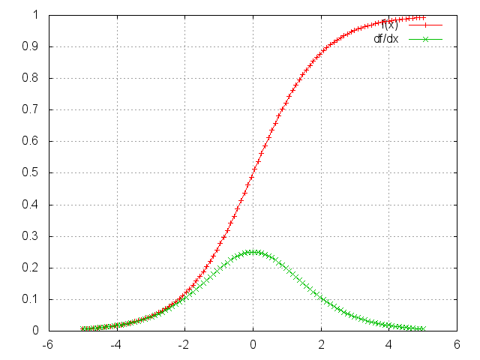
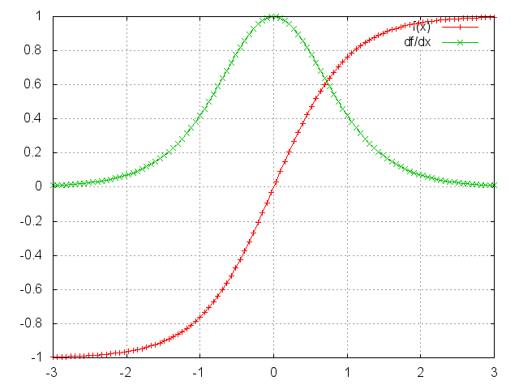
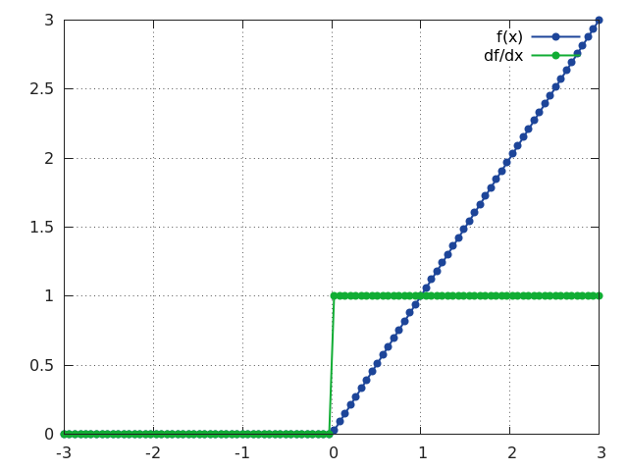
Rectified Linear Unit (ReLU)
Simple, non-saturating activation function
Sigmoid
Hyperbolic tangent
ReLU

Slide 17
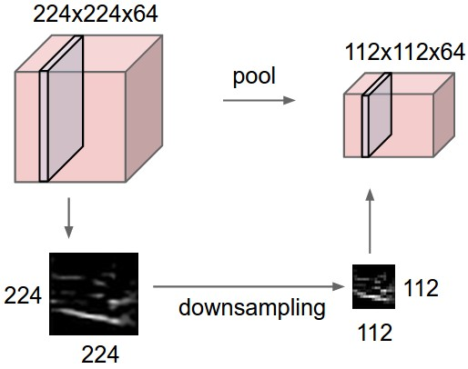
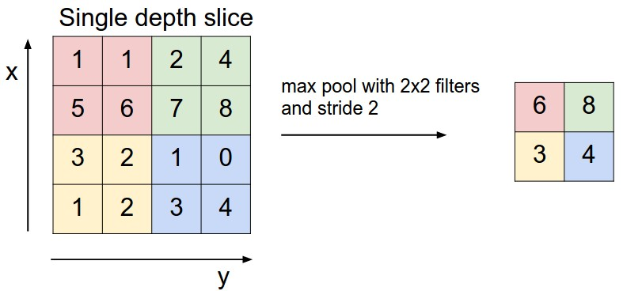
Pooling Layers
Reduce data dimensionality

Slide 18
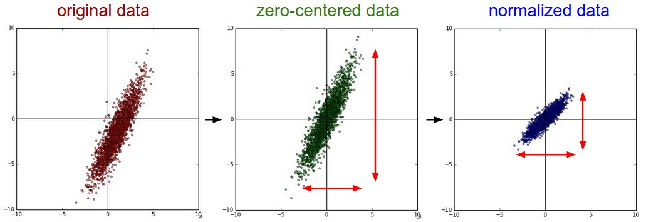
Input Normalization
Remove scale differences across data dimensions
Center data points across input space

Slide 19
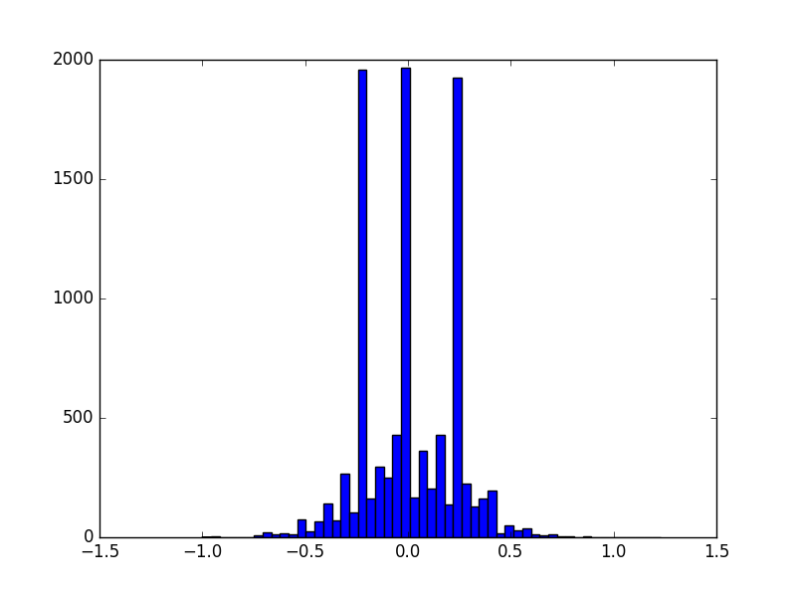
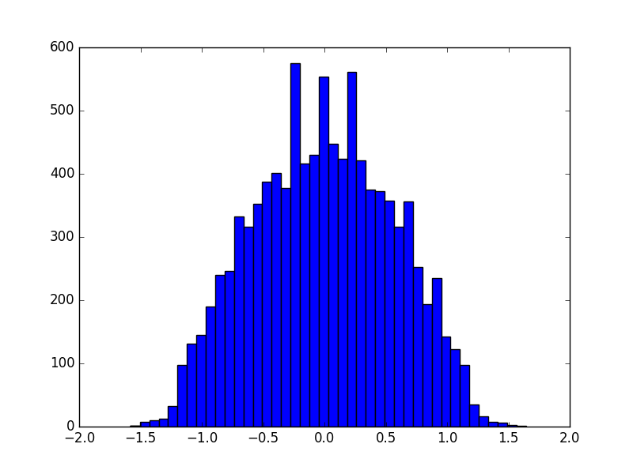
Data Augmentation
Ensure all categories have a similar number of training cases
Translations
Reflections
Pixel perturbations
Number of training cases per category
Before augmentation
After augmentation

Slide 20
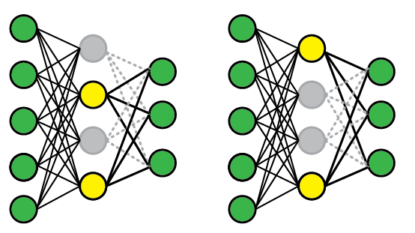
Dropout
Randomly shut down “hidden” neurons during training
Increase variety of cases covered by the network
Reduce neuron co-adaptation
Avoid overfitting
t₁
t₂

Slide 21
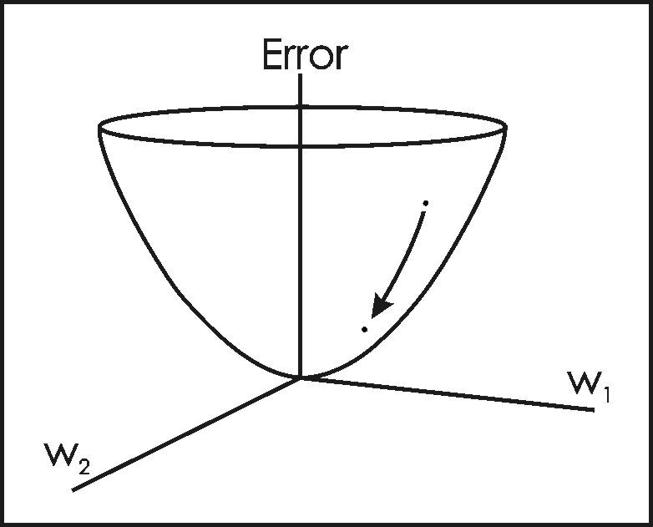
Optimization
Optimize feature extractor (CNN) and classifier (MLP) together
  Stochastic Gradient Descent (SGD)
  Adagrad
  ADAM

Slide 22
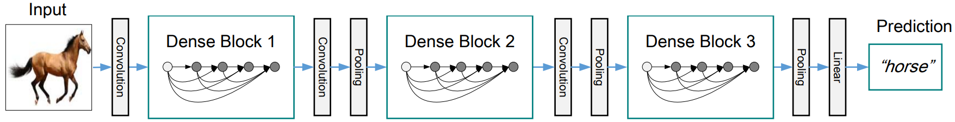
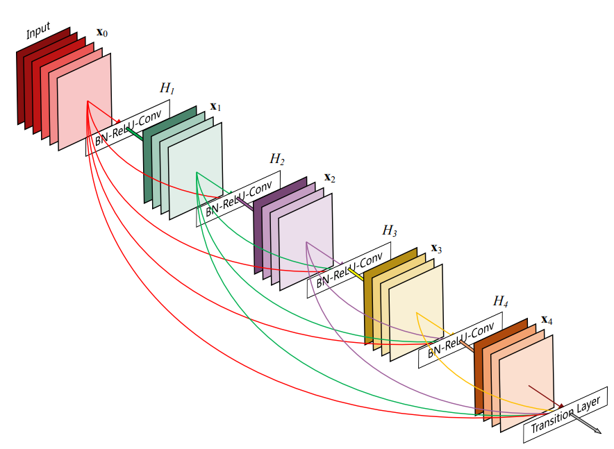
DenseNet
Composed of alternating Dense Blocks and Transition Layers
  Each layer in a Dense Block is fed the output of all previous layers
  Transition Layers perform dimensionality reduction

Slide 23
Conclusion
Multilayer Perceptron Networks (MLP’s)
  Perform feature classification / regression
  Require inputs to be position and scale invariant
Convolutional Neural Networks (CNN’s)
  Extract features from multi-dimensional inputs, e.g. images
  Features are invariant to position and scale
Deep Learning Neural Networks (DLNN’s)
  Combine CNN’s and MLP’s with other supporting techniques
  End-to-end training of feature extractor and classifier / regressor

Slide 24
The End
Questions?

